Slide 1


STRATEGIC PLANNING 101…
Who Knew It Could Be So Easy!

Slide 2
Objectives
Understand the benefits of implementing a Strategic Plan.
Learn the steps involved in a Strategic Planning Process: examples based on the Manatee County Tax Collector’s Strategic Planning model.
Explore opportunities for improvement by developing or maximizing your current Strategic Priorities.

Slide 3
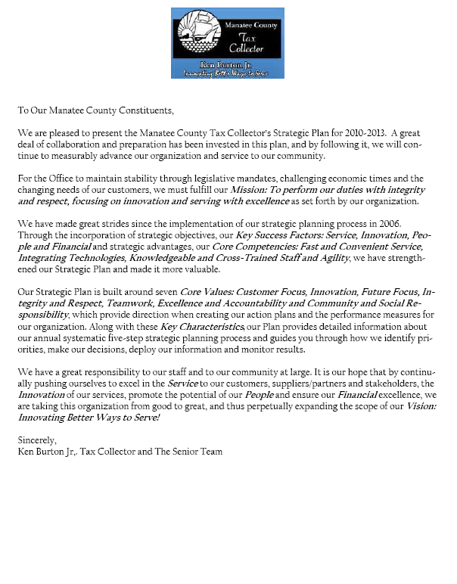

Slide 4
Why A Strategic Plan?
Identify our strategic priorities for the coming year and the next 2 to 3 years.
Obtain and utilize feedback received during our Environmental Assessment Analysis: information from suppliers, partners, stakeholders, dealers, employees and state agencies: helping our strategic focus.
Review what was accomplished the previous year and “Celebrate our Pinnacle Achievements!”

Slide 5
Strategic Planning Process
Annual Systematic 5-Step Strategic Planning Process
Analyze
Approve
Align
Apply
Assess

Slide 6

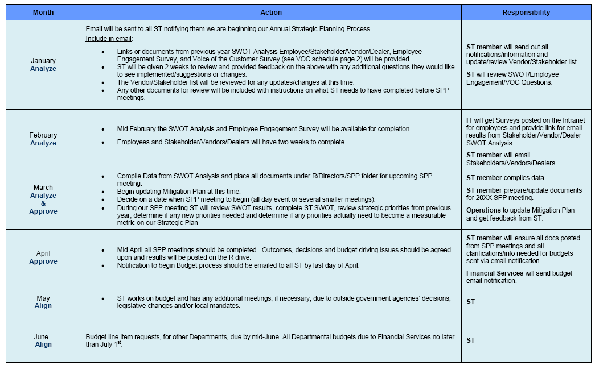
Calendar of Strategic Planning Steps

Slide 7
Step 1 - Analyze
Implementation of the Environmental Assessment Analysis (EAA).
EAA determines if changes have occurred in our products and services, short and long-term strategic challenges or our strategic advantages.
It reveals any “blind spots”.
Completed in two parts: External/Internal External: Business and operation strategic challenges, sustainability, demographics, etc. Internal: Employee engagement/satisfaction.

Slide 8
Step 1 -Analyze – External VOC
Voice of the Customer (VOC) Survey
Key in determining our strategic advantages or Core Competencies:
Fast and Convenient Service
Integrating Technologies
Knowledgeable and Cross-Trained Staff
Agility
Annual schedule: all demographics.

Slide 9
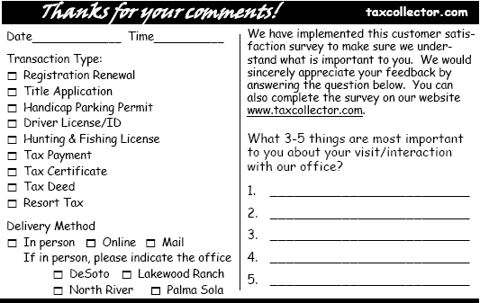
Step 1 Analyze – External (VOC)

Slide 10
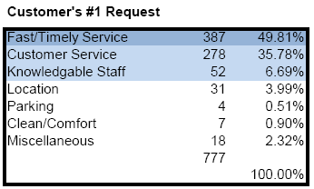
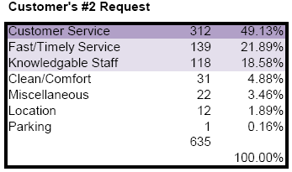
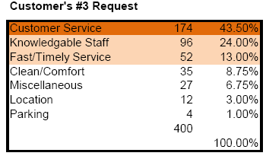
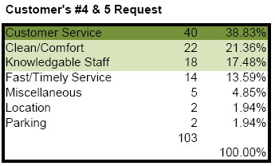
Step1 - Analyze – External (VOC)

Slide 11
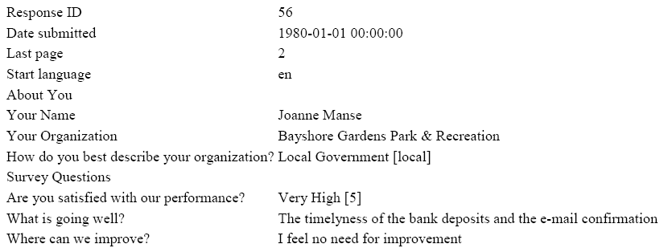
Step 1 Analyze – External Stakeholder/Vendor/Dealer SWOT Analysis
Surveys via Florida Tax Collector’s Association web site/lime surveys.
Email link for survey to our local government, vendors/stakeholders, dealers and state agencies

Slide 12
Step 1 -Analyze – External
Technology/Legislative/Economy
Technology – QR (Quick Response) Codes, NFC (Near Field Communication), Mobile Services, etc.
Legislative Mandates – DL services, Additional Exemptions for Taxes, etc.
Economy – What is going on in your specific county?
All of the above provides data reflective of the changes occurring, and impacts our strategic planning.

Slide 13
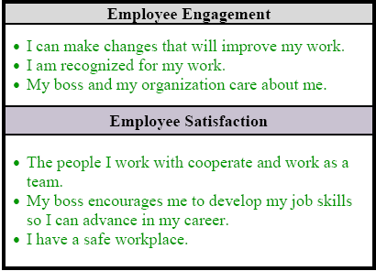
Step1 Analyze - Internal Employee Engagement/Satisfaction Survey
Are We Making Progress? Malcom Baldridge survey.

Slide 14
Step 1 Analyze – Internal Employee SWOT
What do individual employees view as our Strengths, Weaknesses, Opportunities and Threats.
Added in a “further comments” section so employees can explain an answer or provide a more detailed suggestion.
Interview subject matter experts or (SME’s) if a specific issue is identified.

Slide 15
Step 1 Analyze - Internal
Senior Team SWOT Analysis
Strengths: Customer Service Communication Speed of Service Benefits Employee Training/Training Leadership Working Hours (No nights/weekends) Retaining Staff Technology Infrastructure Facilities Great Employees/Staff Vendors/Stakeholders Current Security Stability Agility | Opportunities: More Gov. Contract Opportunities (Revenue) Third Party Providers Kiosks Staff Knowledge/Experiences Database Educate County on Mandates Mobile Services
Weaknesses: Inability for merit pay Centralized Document Management System/Organization of Docs. Records Retention People Dependent Process/Systems Staff levels; work loads | Threats: Mandates Desoto Location (high risk area) Security (civil unrest) Mass Exodus of Employees Records Retention Retirements Increase Number of Customers Legislature/Charter Government Politics State Systems Stability Property Values Dropping

Slide 16

The Senior Team Gets To Work!
M
Tony
Wayne
J & M
Jan
Steve
Burton

Slide 17
Strategic Plan 2010-2013
% Overall Employee Security Satisfaction

Slide 18
Step 2 – Approve
Review strategic priorities from previous year. Any being removed or adjusted?
1 Year Strategic Priorities (2011-2012)
Re-Election of Tax Collector
Replacement of Operations Director
Critical Staffing Losses
Tracking/Engagement of Community Involvement.
Communication

Slide 19
Step 2 – Approve
1 Year Strategic Priorities (2012-2013)
QR Codes/NFC Implementation Office Wide.
Supports our Key Success Factors
Service & Innovation
Mitigation Plan Survey
Supports all Key Success Factors
Service
Innovation
People & Financial

Slide 20
Step 2 – Approve
2/3 Year Strategic Priorities (2012-2013)
Redundant Processes and Systems
Privatized Partnerships
Records Retention Plan Office Wide
Bonus Plan Office Wide.
Critical Staffing Losses
Redesign Taxcollector.com

Slide 21
Step 2 – Approve Breakdown of Strategic Priorities
Senior Team addresses the following when
reviewing our strategic priorities:
Facts
Obstacles
Response to Obstacles/Short Term Goals
Triggers to Reevaluate Strategic Priorities

Slide 22
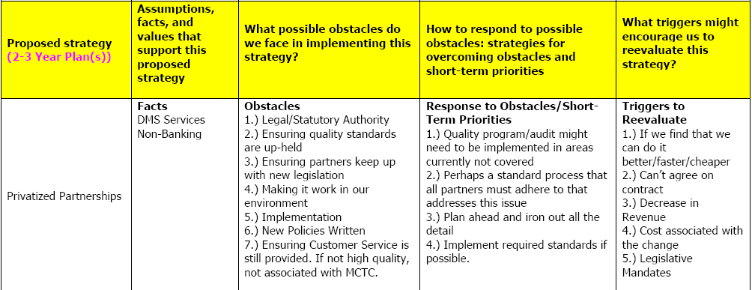
Step 2 – Approve Breakdown of Strategic Priorities

Slide 23
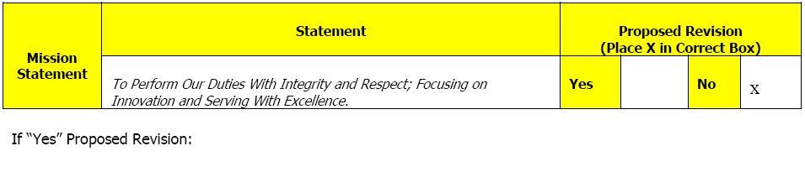
Step 2 – Approve
During our 2012 strategic planning meetings in addition to identifying 3 new priorities and adding 1 new performance measure we had:
20 Action Items
7 Decisions
Affirmation or Revision of Mission, Vision, Core Values, Key Success Factors and Core Competencies.

Slide 24
Step 3 – Align
Long-range financial plans are reviewed and adjusted accordingly, such as large capital acquisitions (technology) or branch expansion plans.
Daily management cash flow placed in alignment with the fiscal budget planning process.
Each Director prepares departmental budgets.
The Senior Team assesses any special budgetary requests.

Slide 25
Step 4 - Apply
Once we have received approval for our organizational budget, the Senior Team deploys/applies our Strategic Plan.
Each Senior Team Director creates a department scorecard with measures aligning to the Organizational Scorecard/Strategic Plan.
Department/Organizational Scorecards inputted into PBL (Process Based Leadership) MCTC’s Communication Tool.

Slide 26
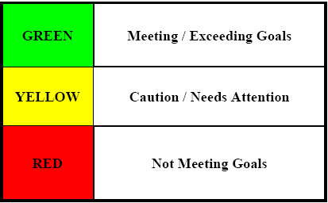
Step 4 – Apply
PBL Communication Tool
Enforcement of systematic reporting, deployment and communication of results.
PBL uses the “stop light” color coded dashboard system which allows the senior team and staff to determine, at-a-glance, the degree of progress for our strategic priorities.

Slide 27
Step 4 – Apply
PBL Communication Tool
Green – Communicate throughout the organization via “pass downs”, celebrated during weekly home team meetings and continue to be monitored.
Yellow and Red - Trigger a call to action. Ensuring we are meeting the performance measures and goals identified on our strategic plan.
If a change is identified communicated via “pass downs” and re-measured until in the Green.

Slide 28
Step 4 – Apply
Weekly Home Team Meetings (All levels) – Everyone recites Mission Statement and reviews Core Value of the week.
Senior Team monthly Organizational Performance Review meetings (OPR’s).
Applying and Deploying the plan through www.taxcollector.com
Suppliers/Partners/Dealers through other forms of communication to ensure alignment to our Strategic Plan.

Slide 29
Step 5 – Assess
The final step of MCTC’s strategic planning process is to Assess. The Senior Team completes this step monthly, through our Organizational Performance Review meetings.
We monitor performance and determine if we are meeting established goals.
If we are not meeting established goals, we put into motion the Performance Improvement Process.

Slide 30
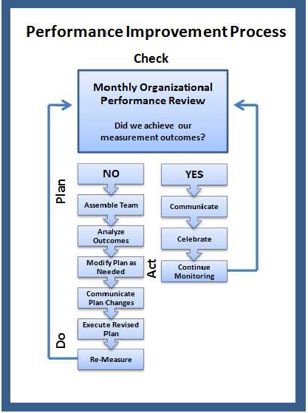
Step 5 – Assess
This process effectively identifies if we are on task with our strategic priorities and overall Strategic Plan.

Slide 31
Strategic Planning Process
Annual Systematic 5-Step Strategic Planning Process
Analyze
Approve
Align
Apply
Assess

Slide 32
So Get Excited!
A strong Strategic Plan will ensure your strategic focus is on target, you are meeting the needs of your customers and most importantly…meeting the needs of your Tax Collector Team!

